Slide 1

Comparing the cost-effectiveness of 2 medical treatments for Chronic Diseases using Markov Analysis
Akshay Danthi
Final project for MSBA-329
Prescriptive Analytics & Optimization
MS in Business Analytics
Golden Gate University

Slide 2
PRESENTATION OUTLINE
Problem Statement
Decision Tree representation
Modeling the Problem using a Decision Tree
Limitation of Decision Tree Modeling – I: Repetition
Limitations of decision tree Modeling – II: Inability to Reuse
Limitations of decision tree Modeling – III: Other issues
Markov model - Description
Markov model Structure – Disease states Representation
Construction of Markov Chain model & performing Cost-Benefit analysis of 2 Treatments for a Chronic Disease
Markov model – Transition Probabilities
Markov matrix and initial transitional probabilities
Markov Model Matrix – Setting up the initial parameters - Initial Transitional Probabilities
Markov Model Matrix – Setting up the initial parameters - Costs (in USD) and Utility values (in QALY’s)
Running the Markov simulation – Finding Intermediate Transitional Probabilities
Running the Markov simulation – Finding The Intermediate Total Expected Costs at each cycle
Running the Markov simulation – Finding The Intermediate Total Expected Utility (in QALY’s) at each cycle
Model output: comparison of transitional probabilities at each cycle
Incremental Cost-Effectiveness Ratio (ICER)
Conclusion: Treatment 2 is better based on our simulation parameters
References

Slide 3
Problem statement
Chronic diseases are characterized by their long duration and persistent effects on health.
The treatment of these conditions involves a careful consideration of Costs and Quality Adjusted Life Years (QALY), a measure that combines life expectancy with the quality of life.
This approach helps healthcare providers assess the cost-effectiveness of treatments, aiming to maximize both the longevity and quality of life for patients.
As such, managing chronic diseases effectively requires a strategic balance between these two crucial factors.
In this project, I aim to compare 2 treatments for a chronic disease by calculating the Incremental Cost-Effectiveness Ratio (ICER) using Markov Chain simulations.

Slide 4
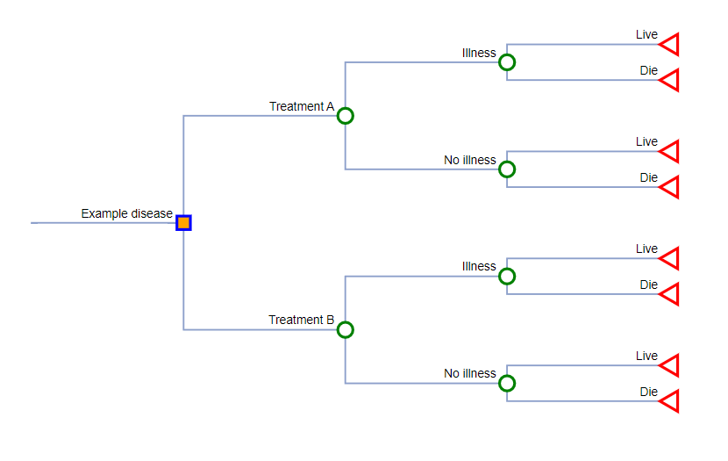
A decision tree REPRESENTING THE STATES: Life, illness, death

Slide 5
Modeling the problem with a decision tree
This problem can be naively modeled using a Decision Tree, as shown in the previous slide, where each branch symbolizes potential events or decision points, leading to further complexities as more outcomes are considered.
Starting with the onset of the disease, the model progresses through critical stages, culminating in the ultimate outcomes: either 'Live' or 'Die’.
The intermediate states, 'Illness' or 'No Illness', reflect the patient's response to treatment, indicating either an ongoing struggle with the disease or a successful mitigation of symptoms.
Each branch and node within the Decision Tree represents key decisions and potential outcomes.

Slide 6
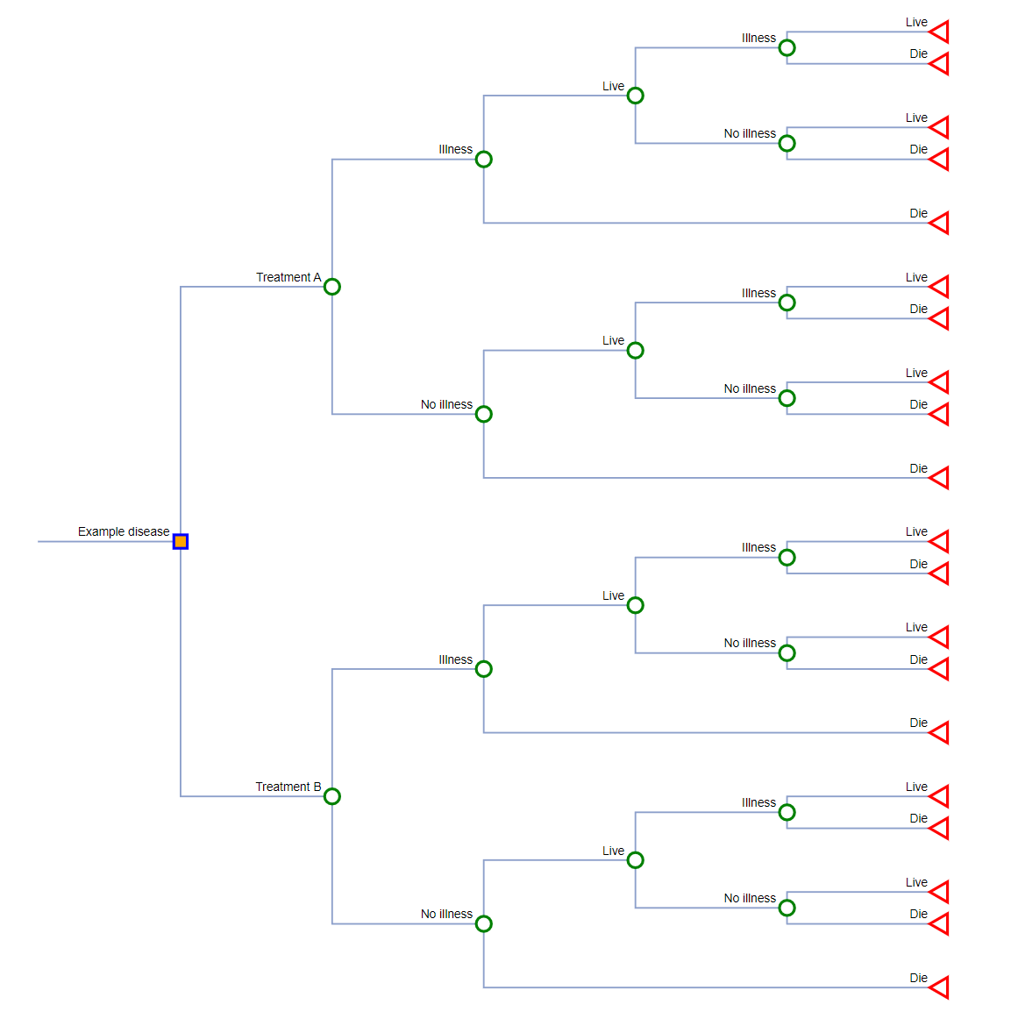
Limitations of decision tree MODELING – I: Repetition
This part of the decision tree is a repeat of the Illness node.
When a subject has an illness, they can live or die. If they live and have another illness, they can live or die once again.
This cycle repeats itself over and over in a decision tree.

Slide 7
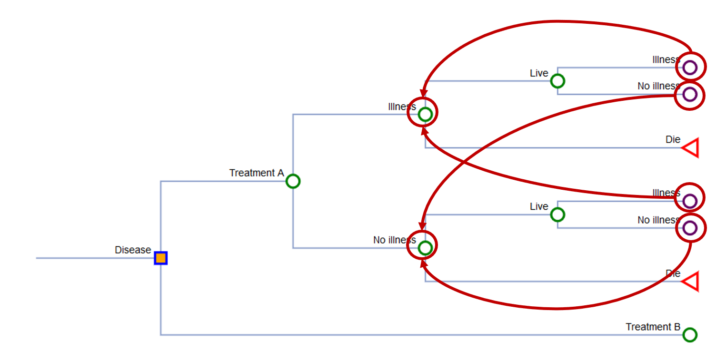
Limitations of decision tree Modeling – II: Inability to reuse
Well → Well
Well → Illness
Well → Death
Illness → Illness
Illness → Well
Illness → Death
Death → Death
With decision trees, there is no return state, i.e. there is no way to represent a patients return to illness or no-illness state and to consider the conditional probabilities involved in these successive intermediate states.

Slide 8
Limitations of decision tree MODELING – III: Other issues
Increasing Complexity: As seen in the previous slide, Decision Trees become exponentially complex as they account for the recurring nature of events in chronic diseases.
Limited Suitability for Long-Term Projections: Their linear and unidirectional paths fail to represent the fluctuating nature of chronic conditions over extended periods.
Computational Demands and Rigidity: Decision trees require significant computational resources and are challenging to update with new data, limiting their practicality.
Reduced Predictive Capability: The lack of feedback loops in decision trees diminishes their ability to accurately predict outcomes for diseases requiring frequent reassessment.

Slide 9
Markov model - description
A Markov model is a mathematical model used to describe systems that transition from one state to another state. It is characterized by the property that the future state depends only on the current state, not on the sequence of events that preceded it.
Key Components of Markov Models:
States: These are distinct conditions or statuses that the subject (e.g., a patient) can be in at any given time. Common states in healthcare Markov models include health states like "Well", "Ill", and "Dead".
Transitions: Movements between states, governed by probabilities that are typically derived from clinical data or expert opinion. Each possible transition has an associated probability.
Transition Probabilities: These are the chances of moving from one state to another in a given cycle (time period), and they are a core element in the setup of Markov models. They must be non-negative and sum to 1 across all possible transitions from a given state.

Slide 10
Markov model Structure – Representation of disease states
Asymptomatic state
Disease state
Absorbing state
Well
Illness
Dead
Costs
Benefits
Assigned to the states

Slide 11
Construction of a Markov Chain model to represent this problem and to perform the Cost-Benefit analysis of 2 Treatments for a Chronic Disease.

Slide 12
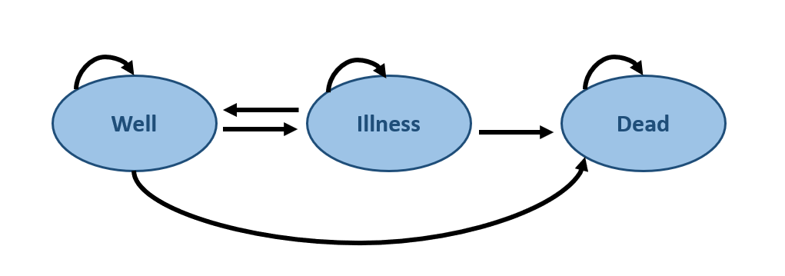
Markov model – transition probabilities
If you have tp2 and tp3, then tp1 = 1 – tp2 – tp3
Well → Well
Well → Illness
Well → Death
Illness → Illness
Illness → Well
Illness → Death
Death → Death
tp1
tp2
tp3
tp4
tp5
tp6
tp7
100%
tp1
tp4
tp7
tp5
tp6
tp2
100%
tp3
Let’s say the state tp1 is a patient being well and remaining well. tp2 represents a patient becoming ill after being well and tp3 represents a patient dying from an illness.
Since these are mutually exclusive states, tp1 would be equal to (1-tp2-tp3), as all the probabilities add up to 1. The same applies to tp4, tp5, tp6 and tp7 states.

Slide 13
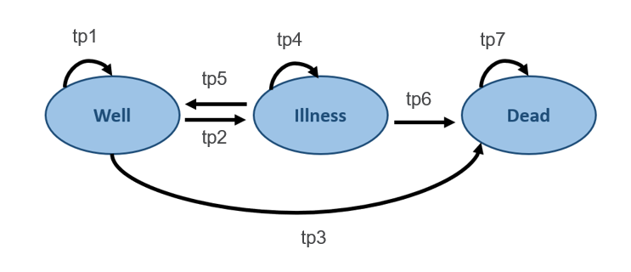
Markov matrix and initial transitional probabilities
From / To | Well | Illness | Dead
Well | tp1 (1 – tp2 – tp3) | tp2 | tp3
Illness | tp5 | tp4 (1 – tp5 – tp6) | tp6
Dead | 0 | 0 | tp7
The probabilities for dead->well and dead->illness are defined as 0.
Similarly, the probability of a patient remaining in dead state after death is defined as 1.

Slide 14
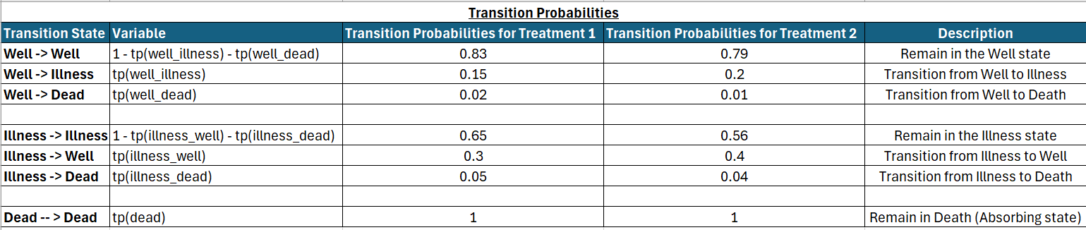
Markov Model Matrix – Setting up the initial parameters - Initial Transitional Probabilities
The probabilities in the Red box are the Initial Transitional Probabilities for Treatment 1.
Similarly, the probabilities in the Yellow box are the Initial Transitional Probabilities for Treatment 2.

Slide 15
Markov Model Matrix – Setting up the initial parameters - costs (in USD) and Utility VALUES (in QALY’s)
Next, the Expected Costs (in USD) for each Treatment for each State – Well, Illness and Dead are entered in the 2nd and 3rd columns of above table. (Sheet 1 “Markov Model Parameters” – A16 to C19 in the Excel Sheet).
Similarly, the Utility values (in QALYs) for each Treatment for each State – Well, Illness and Dead are entered in the 4th and 5th columns of above table. (Sheet 1 “Markov Model Parameters” – D17 to E19 in the Excel Sheet).

Slide 16
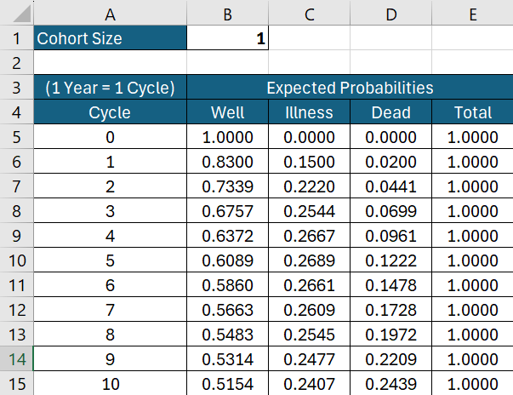
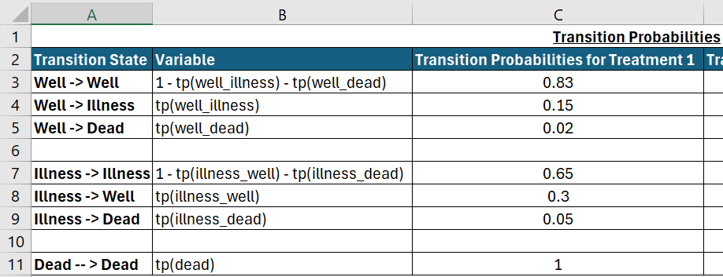
Running the Markov simulation – Finding Intermediate Transitional Probabilities
The intermediate values for Transitional Probabilities for Well, Illness and Dead are calculated by the following formulae: Intermediate Well TP = [(Previous Well Cycle TP) * (Initial Well -> Well TP)] + [(Previous Illness Cycle TP) * (Initial Illness -> Well TP)] Intermediate Illness TP = [(Previous Well Cycle TP) * (Initial Well -> Illness TP)] + [(Previous Illness Cycle TP) * (Initial Illness -> Illness TP)] Intermediate Dead TP = [(Previous Well Cycle TP) * (Initial Well -> Dead TP)] + [(Previous Illness Cycle TP) * (Initial Illness -> Dead TP)] + [Previous Dead Cycle TP]
The Cohort Size (number of participants) for the Simulation is set. Here, it is set to 1 member, but it can be set to any value in the Excel sheet for the Simulation and all the values will be calculated accordingly. This simulation is run for 100 cycles, where 1 Cycle = 1 Year.

Slide 17
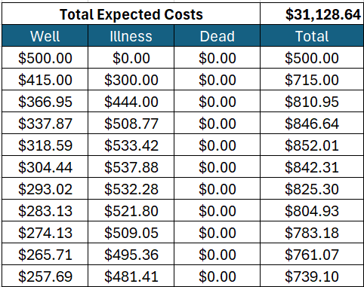
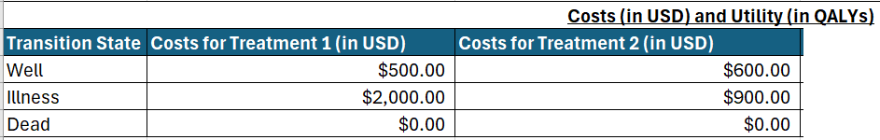
Running the Markov simulation – Finding The Intermediate Total Expected Costs at each cycle
The intermediate Total Expected Cost at each cycle is calculated by: Multiplying the corresponding cycle’s (Well/Illness/Dead) Transitional Probability with the corresponding (Well/Illness/Dead) Initial Cost for treatment. The Total Expected Cost (in USD) is finally calculated by Summing up all the Intermediate Total Costs accrued at each cycle.

Slide 18
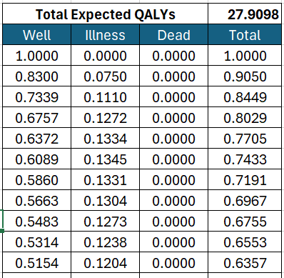
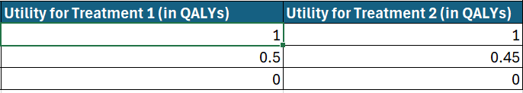
Running the Markov simulation – Finding The Intermediate Total Expected QALY’s (UTILITY) at each cycle
The intermediate Total Expected QALY’s (Utility) at each cycle is calculated by: Multiplying the corresponding cycle’s (Well/Illness/Dead) Transitional Probability with the corresponding (Well/Illness/Dead) Initial Utility value (in QALY’s) for the treatment. The Total Expected QALYs (Utility value) is finally calculated by Summing up all the Intermediate Total QALY’s at each cycle.

Slide 19
Model output: comparison of transitional probabilities at each cycle
We can observe differences in the Transitional Probabilities of the Well, Illness and Dead states plotted along the 100 cycles in our simulation for our Cohort size of 1 member.
The differences can be observed in the highlighted blue circles, where there is a steep decrease in Treatment 2 for Transitional Probabilities in Wellness whereas there is a more Gradual decrease seen in Treatment 1.
Similarly, the Dead Transitional Probability reaches very close to 1 in the final cycles in Treatment 1, while it is further away from being 1 in Treatment 2.

Slide 20

Incremental Cost-Effectiveness Ratio (ICER)
ICER stands for Incremental Cost-Effectiveness Ratio. It is a crucial calculation used in health economics to help decide which medical treatments or interventions provide the best value for money.
The ICER helps policymakers, insurers, and healthcare providers determine whether a new treatment or intervention is economically viable compared to existing alternatives. It assesses the additional cost of a new treatment relative to its additional benefits, usually in terms of health outcomes.
How ICER Is Calculated:
The ICER is calculated by comparing two treatment options: a standard treatment (usually the current or most common treatment; here: Treatment 1) and a new treatment (here: Treatment 2).
The formula for ICER:
where:
ΔC -> is the difference in Cost between the new treatment and the standard treatment.
ΔE -> is the difference in Utility between the new treatment and the standard treatment.
$$ICER= \frac{∆C}{∆E}$$

Slide 21
Conclusion: Treatment 2 is better based on our simulation parameters
Here, the Total Cost (in USD) accrued is the Sum of all costs from each State in each Cycle.
Similarly, the Total Utility value (in QALY’s) accrued is the Sum of all Total QALY’s from each State in each Cycle.
The Incremental Costs (in USD) are calculated as the Difference between the Total Cost of Treatment 1 and Total Cost of Treatment 2. Here, it is calculated as (+) $158.66.
Similarly, The Incremental Utility value (in QALY’s) are calculated as the Absolute Difference between the Total Cost of Treatment 1 and Total Cost of Treatment 2. Here, it is calculated as (-) 9.12 QALYs.
Finally, the Incremental Cost-Effectiveness Ratio (ICER) is calculated as Incremental Costs / Incremental QALYs.
Thus, the ICER for our comparison comes to (-) $17.39. The ICER value is -$17.39/QALY. Normally, ICER is expressed as a positive value, representing the additional cost per additional unit of benefit (e.g., QALY). A negative ICER can occur when the comparator (Treatment 2) is both less costly and more effective than the intervention (Treatment 1), making the comparator "dominant.“
Thus, Treatment 2 is more Cost-Effective based on our Simulation parameters defined in the Excel sheet.

Slide 22
references
Sonnenberg, F. A., & Beck, J. R. (1993). Markov models in medical decision making. Medical Decision Making, 13(4), 322–338. https://doi.org/10.1177/0272989x9301300409
Green, N., Lamrock, F., Naylor, N., Williams, J., & Briggs, A. (2022). Health economic evaluation using Markov models in R for Microsoft Excel Users: A tutorial. PharmacoEconomics, 41(1), 5–19. https://doi.org/10.1007/s40273-022-01199-7
Edlin, R., McCabe, C., Hulme, C., Hall, P., & Wright, J. (2015). Building a markov cost effectiveness model in Excel. Cost Effectiveness Modelling for Health Technology Assessment, 133–143. https://doi.org/10.1007/978-3-319-15744-3_9
Komorowski, M., & Raffa, J. (2016). Markov models and Cost Effectiveness Analysis: Applications in Medical Research. Secondary Analysis of Electronic Health Records, 351–367. https://doi.org/10.1007/978-3-319-43742-2_24

